Slide 1

DR. FAHEEM AKHTAR
Ph.D. (Zhejiang University)
Assistant Professor

Slide 2
What is Bias in Research?
Bias refers to errors or inaccuracies in the data collected. Bias could be introduced by the interviewer, the interviewee, or the situation.
The interviewer could bias the data if proper trust and rapport are not established with the interviewee, or when the responses are either misinterpreted or distorted, or when the interviewer unintentionally encourages or discourages certain types of response through gestures and facial expressions.

Slide 3
What is Bias in Research?
Interviewees can bias the data when they do not come out with their true opinions but provide information that they think is what the interviewer expects of them or would like to hear. Also, if they do not understand the
questions, they may feel diffident or hesitant to seek clarification. They may then answer questions without knowing their importance, and thus introduce bias.
Some interviewees may be turned off because of personal likes and dislikes, or the dress of the interviewer, or the manner in which the questions are put. They may, therefore, not provide truthful answers, but instead, deliberately offer incorrect responses. Some respondents may also answer questions in a socially acceptable manner rather than indicating their true sentiments.

Slide 4
What is Bias in Research?
Biases could be situational as well, in terms of (1) nonparticipants, (2) trust levels and rapport established, and (3) the physical setting of the interview. Nonparticipation, either because of unwillingness or the inability of the interviewee to participate in the study, can bias data inasmuch as the responses of the participants may be different from those of the nonparticipants (which implies that a biased, rather than a representative, set of responses is likely to result)
Bias also occurs when different interviewers establish different levels of trust and rapport with their interviewees, thus eliciting answers of varying degrees of openness. The actual setting in which the interview is conducted might sometimes introduce bias. Some individuals, for instance, may not feel quite at ease when interviewed at the workplace and therefore may not respond frankly and honestly

Slide 5
How to avoid bias in research (Establishing credibility and rapport, and motivating individuals to respond)
Researcher's Demeanor
To be hired and gain credibility, a researcher must project professionalism, enthusiasm, and confidence.
They need to demonstrate knowledge, skills, ability, articulateness, and enthusiasm to establish credibility with the hiring organization.

Slide 6
How to avoid bias in research (Establishing credibility and rapport, and motivating individuals to respond)
Building Rapport and Trust
The primary goal is to make respondents feel sufficiently at ease to give honest, informative, and truthful answers.
This is achieved by:
Clearly stating the purpose of the interview.
Assuring complete confidentiality of their responses.
Being pleasant, sincere, sensitive, and nonevaluative.
Showing genuine interest in their answers.
Allaying any anxieties, fears, suspicions, and tensions.

Slide 7
How to avoid bias in research (Establishing credibility and rapport, and motivating individuals to respond)
Overcoming Suspicion (Especially with Lower-Level Employees)
Employees may be suspicious, believing researchers are on management's "side" and could lead to negative outcomes like layoffs or increased workload.
To counter this, researchers must:
Clarify that their purpose is only to understand the true state of affairs.
Convince respondents that they do not intend to take sides or cause harm.
Explain that results will be reported only in aggregate, without disclosing individual identities.

Slide 8
How to avoid bias in research (Establishing credibility and rapport, and motivating individuals to respond)
Motivating Honest Participation
Researchers can motivate respondents by:
Explaining how their contribution will help the organization.
Stating that they may personally gain from the survey through an improved quality of work life.
Informing them why they were chosen for the interview to foster better communication.

Slide 9
How to avoid bias in research (Effective Questioning Techniques
Funneling: At the beginning of an unstructured interview, it is advisable to ask open‐ended questions to get a broad idea and form some impressions about the situation. For example, a question that could be asked would be:
What are some of your feelings about working for this organization?
From the responses to this broad question, further questions that are progressively more focused may be asked as the researcher processes the interviewees’ responses and notes some possible key issues relevant to the situation. This transition from broad to narrow themes is called the funneling technique.

Slide 10
How to avoid bias in research (Effective Questioning Techniques
Unbiased questions: It is important to ask unbiased questions to ensure that you minimize bias in the responses.
For example, “Tell me how you experience your job” is a better question than, “Boy, the work you do must be really boring; let me hear how you experience it.” The latter question is “loaded” in terms of the interviewer’s own perceptions of the job. A loaded question might influence the types of answers received from the respondent. Bias could also be introduced by emphasizing certain words, by tone and voice inflections, and through inappropriate suggestions.

Slide 11
How to avoid bias in research (Effective Questioning Techniques
Clarifying issues: To ensure the researcher accurately understands the respondent’s views, it is helpful to restate or rephrase key points.
For example, if a respondent says, “Promotions here are unfair; juniors always get promoted,” the researcher might reply, “So you mean capable seniors are overlooked for promotion?”—this helps confirm meaning.
Similarly, if a respondent says, “The facilities are poor; we work even when dying of thirst,” the researcher could ask whether drinking water is available. Clarifying questions like these help prevent misunderstandings and ensure accurate interpretation.

Slide 12
How to avoid bias in research (Effective Questioning Techniques
Helping the respondent to think through issues: If the respondent is not able to verbalize her perceptions, or replies, “I don’t know,” the researcher should ask the question in a simpler way or rephrase it.
For instance, if a respondent is unable to specify what aspects of the job he dislikes, the researcher might ask the question in a simpler way. For example, the respondent might be asked which task he would prefer to do: serve a customer or do some filing work. If the answer is “serve the customer,” the researcher might use another aspect of the respondent’s job and ask the paired‐choice question again. In this way, the respondent can sort out which aspects of the job he likes better than others.

Slide 13
How to avoid bias in research (Effective Questioning Techniques
Taking notes: During interviews, researchers should take written notes immediately rather than relying on memory, as recalled information can be inaccurate and confusing, especially after multiple interviews. Relying on memory may also introduce bias. Interviews can be audio-recorded if participants agree, but recordings may influence responses since participants know they are being recorded. Therefore, researchers should ensure that recording will not bias the data and must always get the respondent’s permission before doing so.

Slide 14
TYPES OF VARIABLES
Variable
- Any characteristic which is subject to change and can have more than one value such as age, intelligence, motivation, gender, etc.
- Variables are “changing qualities or characteristics” of persons or things like age, gender, intelligence, ideas, achievements, confidence, and so on that are involved in your research study.

Slide 15
BASIC TYPES
Dependent Variables – DV
The dependent variable is the variable of primary interest to the researcher. The researcher’s goal is to understand and describe the dependent variable, or to explain its variability, or predict it. In other words, it is the main variable that lends itself for investigation as a viable factor. Through the analysis of the dependent variable (i.e., finding what variables influence it), it is possible to find answers or solutions to the problem.
• Variable affected by the independent variable
• It responds to the independent variable.

Slide 16
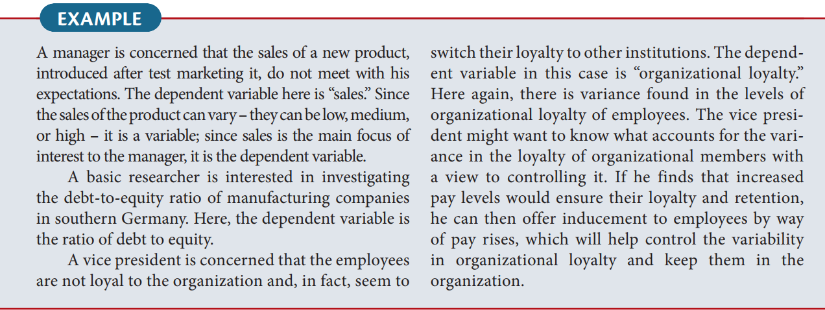
BASIC TYPES

Slide 17

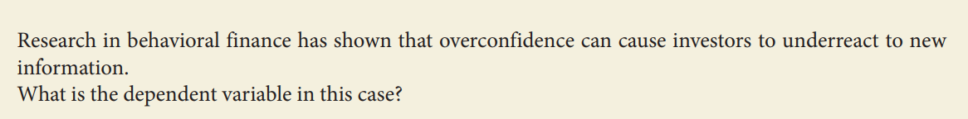
BASIC TYPES

Slide 18
BASIC TYPES
2. Independent Variables – IV
Independent variable is one that influences the dependent variable in either a positive or negative way. That is, when the independent variable is present, the dependent variable is also present, and with each unit of increase in the independent variable, there is an increase or decrease in the dependent variable. In other words, the variance in the dependent variable is accounted for by the independent variable.
• Variable that is presumed to influence other variable.
• It is the presumed cause, whereas the dependent variable is the presumed effect.

Slide 19
BASIC TYPES
To establish that a change in the independent variable causes a change in the dependent variable, four conditions should be met:
1. The independent and the dependent variable should covary: in other words, a change in the dependent variable should be associated with a change in the independent variable.
Example:
Let’s say you are studying the relationship between study time (independent variable) and exam score (dependent variable).
When students increase their study time, their exam scores go up.
When students study less, their exam scores drop.
This shows covariation — changes in the independent variable (study time) are associated with changes in the dependent variable (exam score).

Slide 20
BASIC TYPES
2. The independent variable (the presumed causal factor) should precede the dependent variable. In other words, there must be a time sequence in which the two occur: the cause must occur before the effect.
Example:
Suppose a researcher wants to study whether training programs (independent variable) improve employee performance (dependent variable).
First, the organization conducts the training program.
After the training, the researcher measures employee performance through evaluations or productivity levels.
If the improvement in performance happens after the training, it suggests that the cause (training) came before the effect (better performance).

Slide 21
BASIC TYPES
3. No other factor should be a possible cause of the change in the dependent variable. Hence, the researcher should control for the effects of other variables.
Example:
A researcher wants to find out whether exercise (independent variable) causes weight loss (dependent variable).
However, other factors, such as diet, sleep, or metabolism — can also affect weight loss. To make sure that exercise is the real cause, the researcher must control these other variables.
Example:
All participants follow the same diet.
They get similar amounts of sleep.
The study lasts for the same duration for everyone.
After controlling these factors, if those who exercise more still lose more weight, it supports the conclusion that exercise, not diet or sleep, caused the weight loss.

Slide 22
BASIC TYPES
4. A logical explanation (a theory) is needed and it must explain why the independent variable affects the dependent variable
Example:
A researcher studies how employee motivation (independent variable) affects job performance (dependent variable).
To justify this relationship, a logical explanation or theory is needed, for instance, Self-Determination Theory (SDT).
According to SDT, when employees feel motivated because their work satisfies needs for autonomy, competence, and relatedness, they become more engaged and perform better.
So, the theory explains why motivation leads to higher performance:
Motivation → increases effort, focus, and persistence → leads to better job performance.

Slide 23
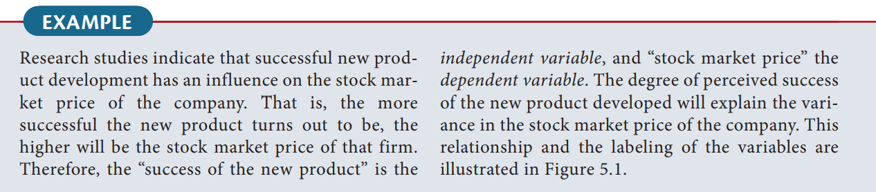
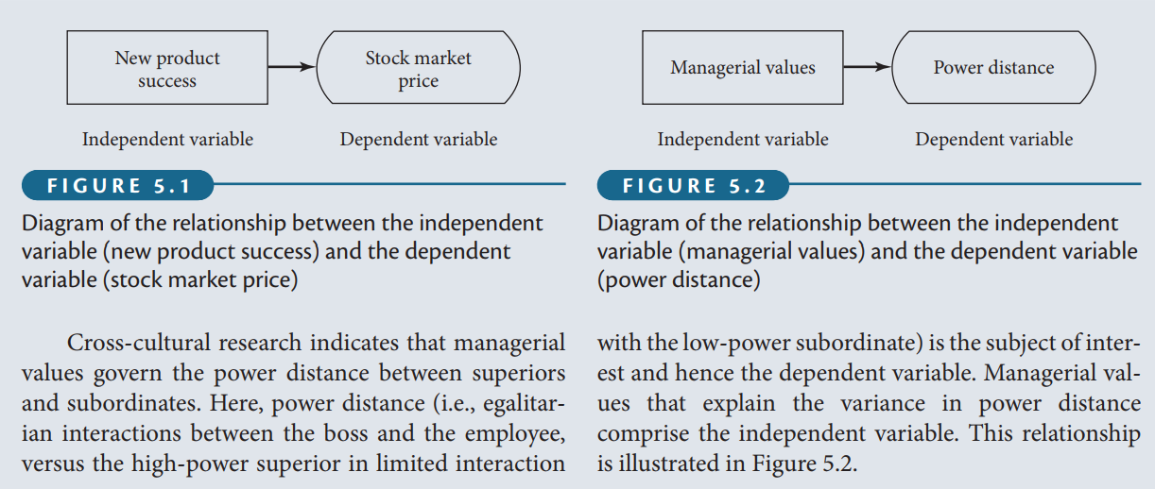
BASIC TYPES

Slide 24
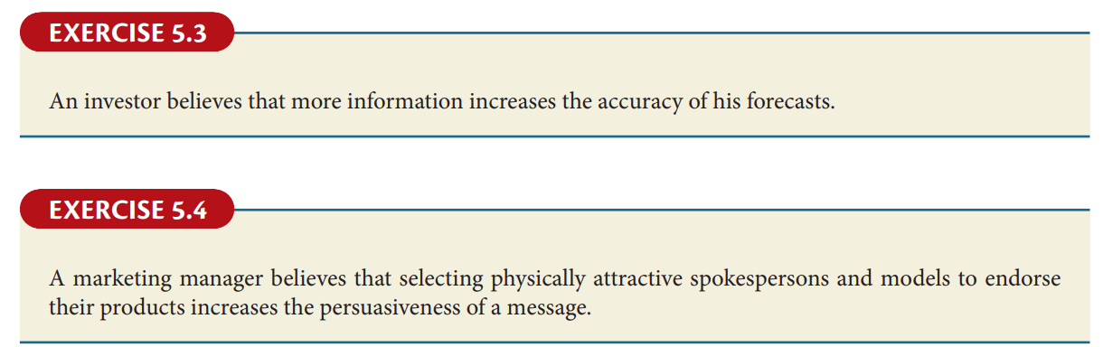
BASIC TYPES

Slide 25
BASIC TYPES
Other Names
Dependent Variable | Independent Variable
Explained | Explanatory
Predictand | Predictor
Regressand | Regressor
Response | Stimulus
Outcome | Covariate

Slide 26
BASIC TYPES
Test Your Understanding.
For each question, choose the dependent variable. A tip for completing: First choose the two main variables from the statement. Then figure out which one is the DV (it’s the one that depends on the other one).
Q1: You are conducting an experiment to see if exposure to more sunlight increases happiness levels for workers who typically spend the entire day in windowless offices.
Sunlight
Happiness level
Windowless offices
Time of day.

Slide 27
BASIC TYPES
Q2: An experiment in a climate-controlled greenhouse concludes that water level, fertilizer and nutrient level in soil affects how tall plants grow. Plants grew an average of 12″ taller if treated with optimal resources.
The greenhouse
Water level, fertilizer and nutrient levels
How tall the plants grow
Optimal resources.

Slide 28
BASIC TYPES
Q3: A researcher suspects that a cholera outbreak is happening because of tainted wells in the city. Most of the cases are clustered around public wells that draw their water from the underground aquifer.
The underground aquifer
Cholera
Wells
The City

Slide 29
BASIC TYPES
Q4: Studies have shown that regular vaccination is effective in controlling the spread of influenza. However, studies also show that a combination of two antiviral medications (oseltamivir and zanamivir) can also control the spread of the disease.
Oseltamivir
Zanamivir
Both 1 and 2
Influenza

Slide 30
BASIC TYPES
Q5: Researchers investigated whether the introduction of a carbon taxation policy reduces national carbon emissions through changes in industrial energy consumption behavior. The study compared countries with and without carbon taxes over a 10-year period.
Carbon taxation policy
Industrial energy consumption behavior
National carbon emissions
Countries

Slide 31
BASIC TYPES
Moderating variable:
The moderating variable is one that has a strong contingent effect on the independent variable–dependent variable relationship. That is, the presence of a third variable (the moderating variable) modifies the original relationship between the independent and the dependent variables.
So, whenever the relationship between the independent variable and the dependent variable becomes contingent or dependent on another variable, we say that the third variable has a moderating effect on the independent variable–dependent variable relationship. The variable that moderates the relationship is known as the moderating variable.

Slide 32
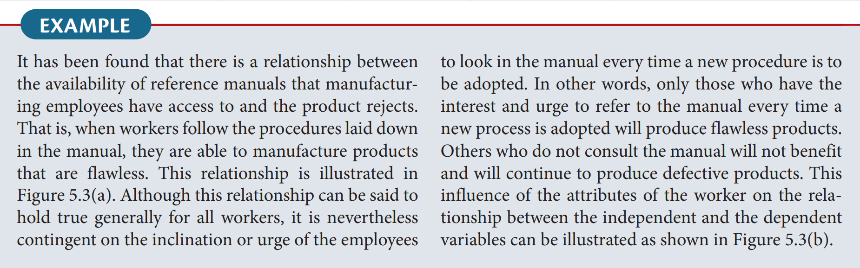
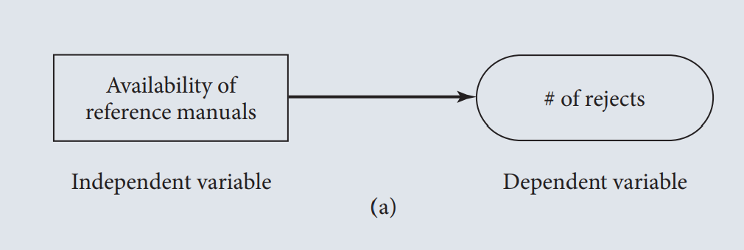
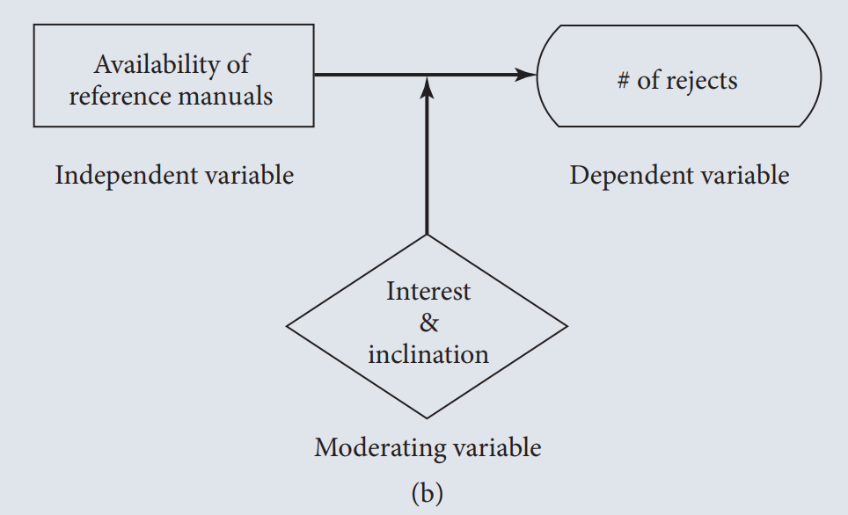
BASIC TYPES

Slide 33
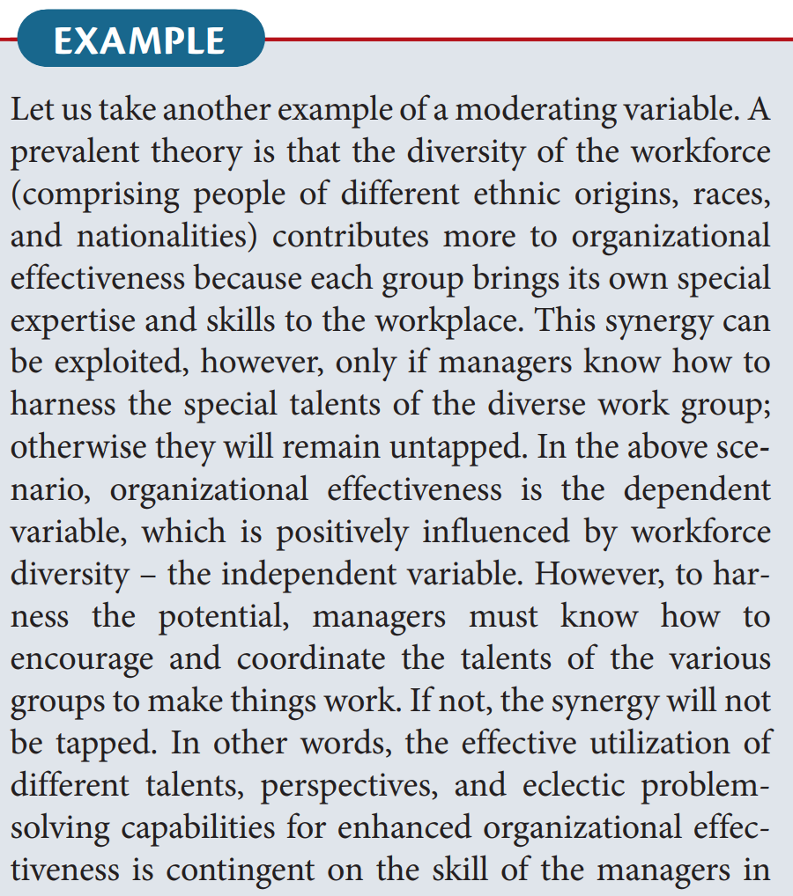
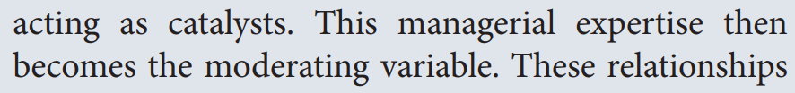

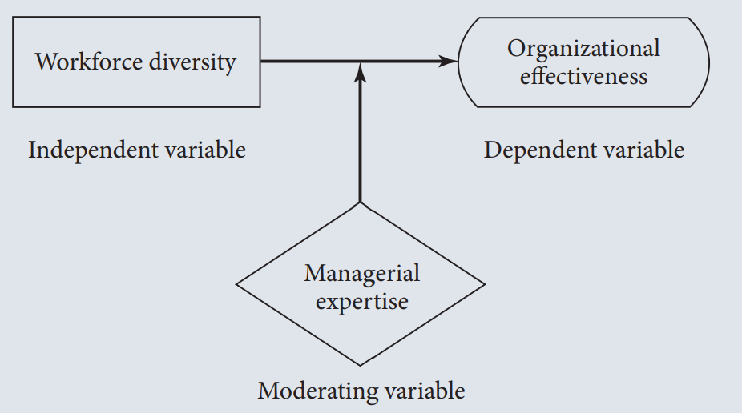

Slide 34
BASIC TYPES
Mediating variable:
A mediating (or intervening) variable is a factor that comes into effect between the independent and dependent variables, showing how or why the independent variable influences the outcome. It represents a process that unfolds over time: first, the independent variable affects the mediator, and then the mediator impacts the dependent variable. In simple terms, a mediating variable helps explain the connection or pathway through which one variable influences another.

Slide 35
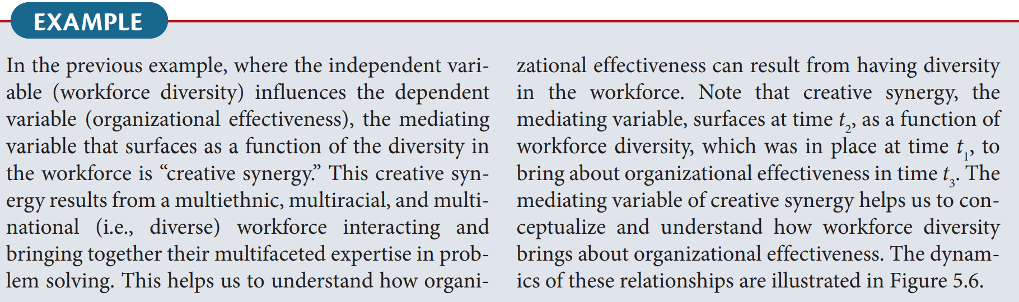

Slide 36
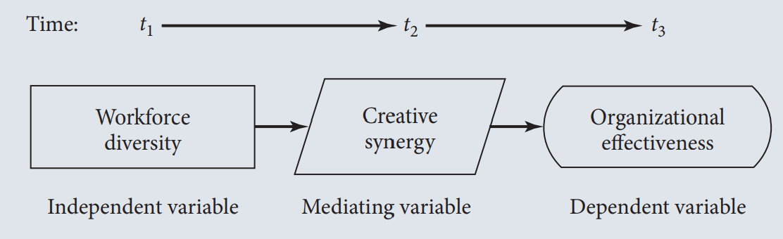

Slide 37
How the inclusion of the moderating variable, “managerial expertise” in the foregoing example, would change the model or affect the relationships. The new set of relationships that would emerge in the presence of the moderator is depicted in Figure 5.7. As can be seen, managerial expertise moderates the relationship between workforce diversity and creative synergy. In other words, creative synergy will not result from the multifaceted problem‐solving skills of the diverse workforce unless the manager is capable of harnessing that synergy by creatively coordinating the different skills. If the manager lacks the expertise to perform this role, then no matter how many different problem‐solving skills the diverse workforce might have, synergy will just not surface. Instead of functioning effectively, the organization might just remain static, or even deteriorate.

Slide 38
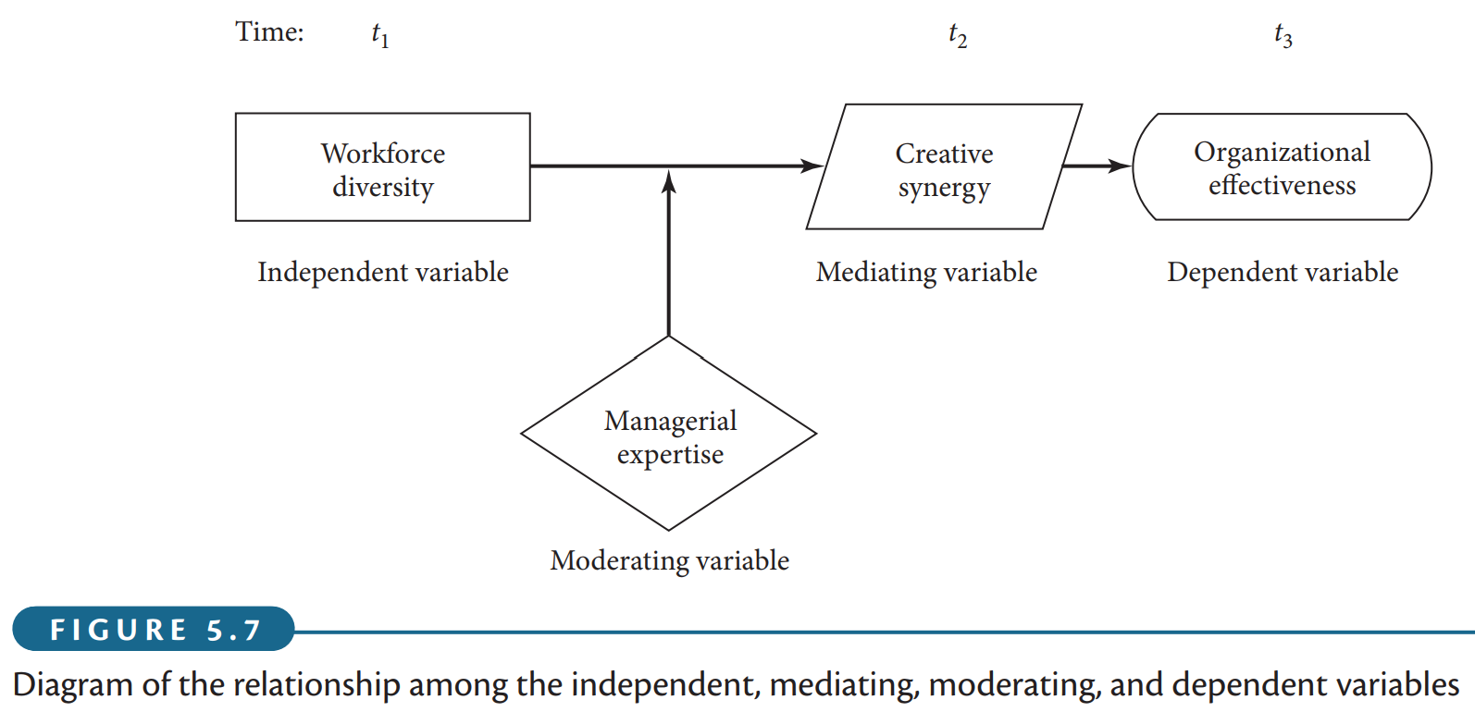

Slide 39
It is now easy to see what the differences are among an independent variable, a mediating variable, and a moderating variable. The independent variable helps to explain the variance in the dependent variable; the mediating variable surfaces at time t₂ as a function of the independent variable, which also helps us to conceptualize the relationship between the independent and dependent variables; and the moderating variable has a contingent effect on the relationship between two variables. To put it differently, while the independent variable explains the variance in the dependent variable, the mediating variable does not add to the variance already explained by the independent variable, whereas the moderating variable has an interaction effect with the independent variable in explaining the variance. That is, unless the moderating variable is present, the theorized relationship between the other two variables considered will not hold.

Slide 40
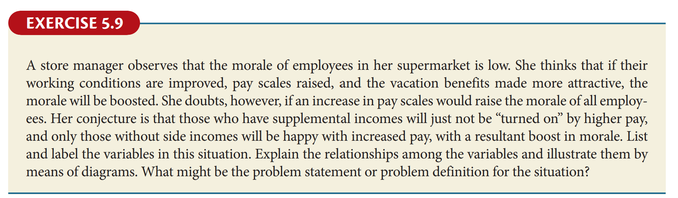

Slide 41
Dependent Variable: Employee morale,
Independent Variables: pay scale
Moderating Variable: Supplemental income
Problem Statement or Problem Definition: To investigate the factors that influence employee morale in a supermarket setting, specifically examining the effects of improved working conditions, increased pay scales, and enhanced vacation benefits. Additionally, to determine whether the presence of supplemental income among employees moderates the relationship between pay scales and morale, thereby identifying targeted strategies to effectively boost morale across different employee groups.

Slide 42
Pay Scales
Employee Morale
Supplemental Income

Slide 43
How theory is Generated
1- Theory generation begins with a foundation of investigation. Researchers first identify a core problem and then determine the key variables that influence it. This is achieved through a thorough literature review and exploratory research like interviews and observations.
3- Finally, this framework allows for the development of specific, testable hypotheses. The validation of the generated theory comes from empirically testing these hypotheses. The results indicate whether the theory is supported, thereby refining it and demonstrating its power to address the original problem.
2- Next, these variables are logically interconnected to form a theoretical framework. This framework is a structured model that elaborates the network of relationships among the variables. It serves as the essential blueprint for the research, explaining how and why the variables are linked.

Slide 44
The components of the theoretical framework
A theoretical framework must identify and clearly define all relevant variables, including independent, dependent, moderating, and mediating variables.
It should explain how these variables are interrelated, including why certain variables act as moderators or mediators.
Any interrelationships among multiple independent or dependent variables should also be clarified.
The framework must include a conceptual model, presented both as a diagram and in written form, to show how variables connect and to structure the literature discussion.

Slide 45
The components of the theoretical framework
Each proposed relationship should be supported by theory, explaining the expected direction and nature of the relationship.
Variable definitions must come from credible academic sources, because they guide both theoretical justification and measurement during data collection.
In applied research, existing theories are typically used to explain relationships; in basic research, new theoretical insights may be required when current theories are insufficient.

Slide 46
HYPOTHESIS DEVELOPMENT
A hypothesis can be defined as a tentative, yet testable, statement, which predicts what you expect to find in your empirical data. Hypotheses are derived from the theory on which your conceptual model is based and are often relational in nature. Along these lines, hypotheses can be defined as logically conjectured relationships between two or more variables expressed in the form of testable statements. By testing the hypotheses and confirming the conjectured relationships, it is expected that solutions can be found to correct the problem encountered.

Slide 47
Statement of Hypotheses: Formats
If–then statements
As already stated, a hypothesis can be defined as a testable statement of the relationship among variables. A hypothesis can also test whether there are differences between two groups (or among several groups) with respect to any variable or variables. To examine whether or not the conjectured relationships or differences exist, these hypotheses can be set either as propositions or in the form of if–then statements. The two formats can be seen in the following two examples.
Statement: Customers will be more likely to remember a brand when they see the advertisement repeatedly.
If–Then Version: If customers are exposed to an advertisement more frequently, then they will be more likely to remember the brand.
Statement: Customers will be more likely to choose a product when it has eye-catching packaging.
If–Then Version: If a product has eye-catching packaging, then customers will be more likely to choose it.

Slide 48
Statement of Hypotheses: Formats
Directional and nondirectional hypotheses
If, in stating the relationship between two variables or comparing two groups, terms such as positive, negative, more than, less than, and the like are used, then these are directional hypotheses because the direction of the relationship between the variables (positive/negative) is indicated, as in the first example below, or the nature of the difference between two groups on a variable (more than/less than) is postulated, as in the second example.
The greater the stress experienced in the job, the lower the job satisfaction of employees.
Women are more motivated than men.

Slide 49
Statement of Hypotheses: Formats
Directional and nondirectional hypotheses
Nondirectional hypotheses are those that do postulate a relationship or difference, but offer no indication of the direction of these relationships or differences. In other words, though it may be conjectured that there is a significant relationship between two variables, we may not be able to say whether the relationship is positive or negative, as in the first example below. Likewise, even if we can conjecture that there will be differences between two groups on a particular variable, we may not be able to say which group will be more and which less on that variable, as in the second example.
There is a relation between arousal‐seeking tendency and consumer preferences for complex product designs.
There is a difference between the work ethic values of American and Asian employees.
Nondirectional hypotheses are formulated either because the relationships or differences have never been explored, and hence there is no basis for indicating the direction, or because there have been conflicting findings in previous research studies on the variables.

Slide 50
Statement of Hypotheses: Formats
Null and alternate hypotheses
Purpose of the Null Hypothesis (H₀): The null hypothesis is set up with the explicit goal of being rejected. Its rejection provides statistical support for the researcher's actual theory, which is stated as the alternate hypothesis.
The "Default" and "No Effect" Position: The null hypothesis is the default assumption that there is no relationship between two variables or no difference between two groups. It represents the conclusion that any observed effect in the sample is due to random chance (sampling fluctuations) and not a true effect in the population.
Example: H₀: Motivation levels of Men and Women are equal (H₀: μ_M = μ_W).
3. Role of the Alternate Hypothesis (H_{A} or H₁): The alternate hypothesis is the researcher's prediction of a relationship, difference, or effect. It is the statement they want to validate. It is the logical opposite of the null hypothesis.
Example: H_{A}: Women are more motivated than men (H_{A}: μ_W > μ_M).

Slide 51
Statement of Hypotheses: Formats
Null and alternate hypotheses
4. Falsifiability: The hypothetico-deductive method requires that hypotheses be falsifiable. The structure of null hypothesis testing makes this possible because the null (stating "no effect") is a concrete claim that can be statistically tested and potentially rejected.
5. Statistical Conclusion: The outcome of a statistical test tells us whether to reject or not reject the null hypothesis.
If the test shows the results are statistically unlikely under the null hypothesis (e.g., p < 0.05), we reject H₀ and thereby find support for the alternate hypothesis (H_A).
If the results are not statistically significant, we fail to reject H₀. We do not "prove" the null; we simply lack sufficient evidence to support the alternate.

Slide 52
Statement of Hypotheses: Formats
Null and alternate hypotheses
Directionality:
Directional (One-tailed) Tests: The alternate hypothesis specifies the direction of the effect (e.g., "greater than," "less than"). The example "Women are more motivated than men" is directional.
Non-Directional (Two-tailed) Tests: The alternate hypothesis only states that there is a difference, but not its direction (e.g., "is not equal to"). The example on work ethic values ("There is a difference between Americans and Asians") is non-directional.

Slide 53
Individual Activity:
Write your research title and determine your variables. What might be the problem statement or problem definition for the situation as well framework of your study, theory and hypothesis? Please make presentation for next class

Slide 54
Thanks

